Slide 1

DATA 824 Final Project Shiny App: DUI and Fatalities across the United States
By: Aishwarya Sunil

Slide 2
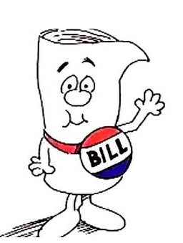
Introduction
Recently, the state of Indiana proposed a bill that would legalize Sunday package sales of alcoholic beverages for carry-out. This bill aims to modernize alcohol sales regulation and boost profits of local businesses. However, the concern is that this change may lead to increased DUIs (driving under the influence) and vehicle-related fatalities due to higher alcohol consumption and easier access to alcohol.

Slide 3
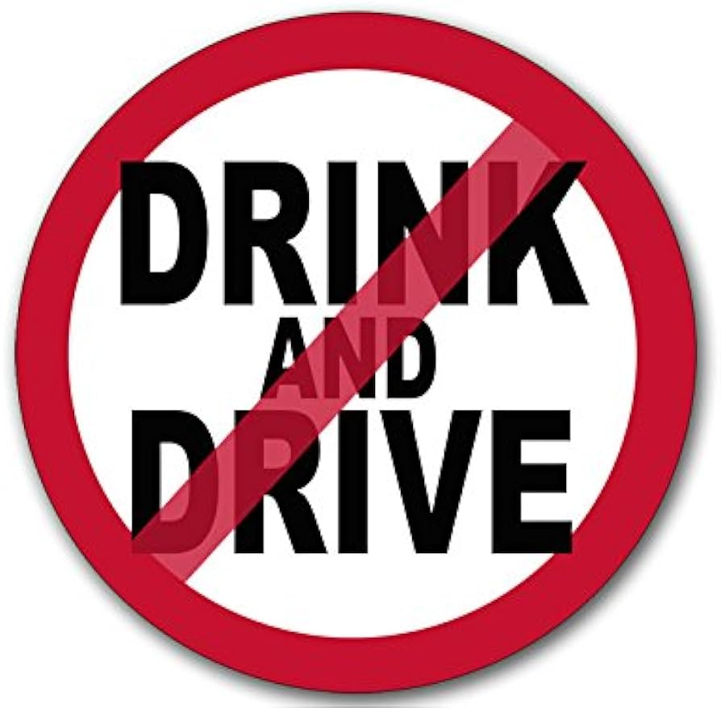
Background
According to the National Highway Traffic Safety Administration one person in the United States dies every 39 minutes (about 37 people a day) due to drunk driving related crashes.
Drunk driving fatalities in the U.S. have decreased by 15%, since 1991, due to stricter laws, improved vehicle safety, and public awareness.
The new Indiana law will end the ban on Sunday package sales and put forth new liquor liability insurance requirements for establishments. Opponents argue that this could lead to increased drunk driving incidents and fatalities.

Slide 4

Background
The object of this project is to use the DUI dataset to identify DUI and vehicle-related fatality trends in the United States. Specifically, it will focus on whether different alcohol sale regulations have a negative or positive correlation to DUI rates and fatalities.
Understanding the effects of such legislation is crucial for informed policy-making. This app aims to provide insights into whether legalizing Sunday package sales could potentially affect public safety.

Slide 5
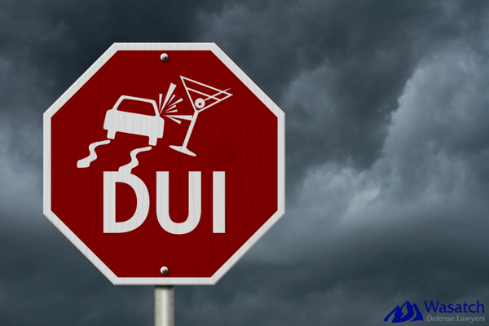
Data Overview
The dataset used in this analysis contains information on DUI incidents, fatalities, state populations, and Sunday sales across all 50 U.S. states.
Data Source: The data was obtained from Kaggle which was obtained from the Foundation for Advancing Alcohol Responsibility.
Variables include:
State: The U.S. state where the data was collected.
DUI: The number of DUI incidents reported in the state.
Fatalities: The number of fatalities related to DUI incidents in the state.
Population: The population of the state.
Sunday.Sales: The regulation status regarding the sale of alcoholic beverages for carry-out on Sundays. Categories include:
Permitted: Alcohol sales are allowed on Sundays.
Prohibited: Alcohol sales are not allowed on Sundays.
Local: Local jurisdictions have their own regulations.
Restricted: Sales are allowed with some restrictions.
Comparing states with Permitted and Prohibited Sunday sales can help deduce whether the proposed regulation may impact DUI rates and fatalities.

Slide 6

Application Overview
The purpose of this Shiny app is to provide an interactive platform for analyzing DUI incidents and vehicle-related fatalities across all 50 U.S. states. The app allows users to explore various visualizations and gain insights into the relationships between all the variables.
Users can mix and match variables for the X and Y axes to customize a plot of their choosing.
The app contains multiple tabs with a user-friendly interface, allowing easy navigation between different visualizations and controls.
Users can interact with charts and tables to explore the data to gain a deeper insight into the data being presented.

Slide 7
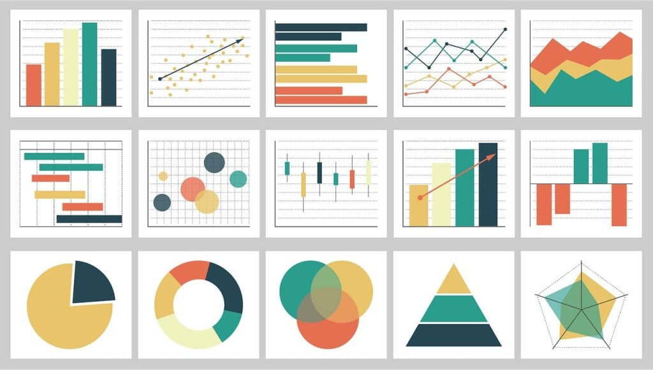
Application Overview
Visualizations:
Bar Charts: Visualize the total number of DUI incidents and fatalities by state. Users can compare DUI and fatality rates across states to see how they are affected by alcohol sales regulations.
Scatter Plots: Analyze the relationship between DUI incidents and fatalities, and between DUI incidents and state population to help identify correlations and trends.
Box Plots: Examine the distribution of DUI incidents by Sunday sales regulation to understand how different sales regulations influence DUI rates.
Pie Chart: Shows the distribution of DUI incidents based on Sunday sales regulations, providing a comparative view of DUI counts under different regulatory conditions.
Summary Table: Displays key statistics such as total, average, maximum, minimum, median, and standard deviation of DUI incidents and fatalities to provide a numerical summary of the data.

Slide 8
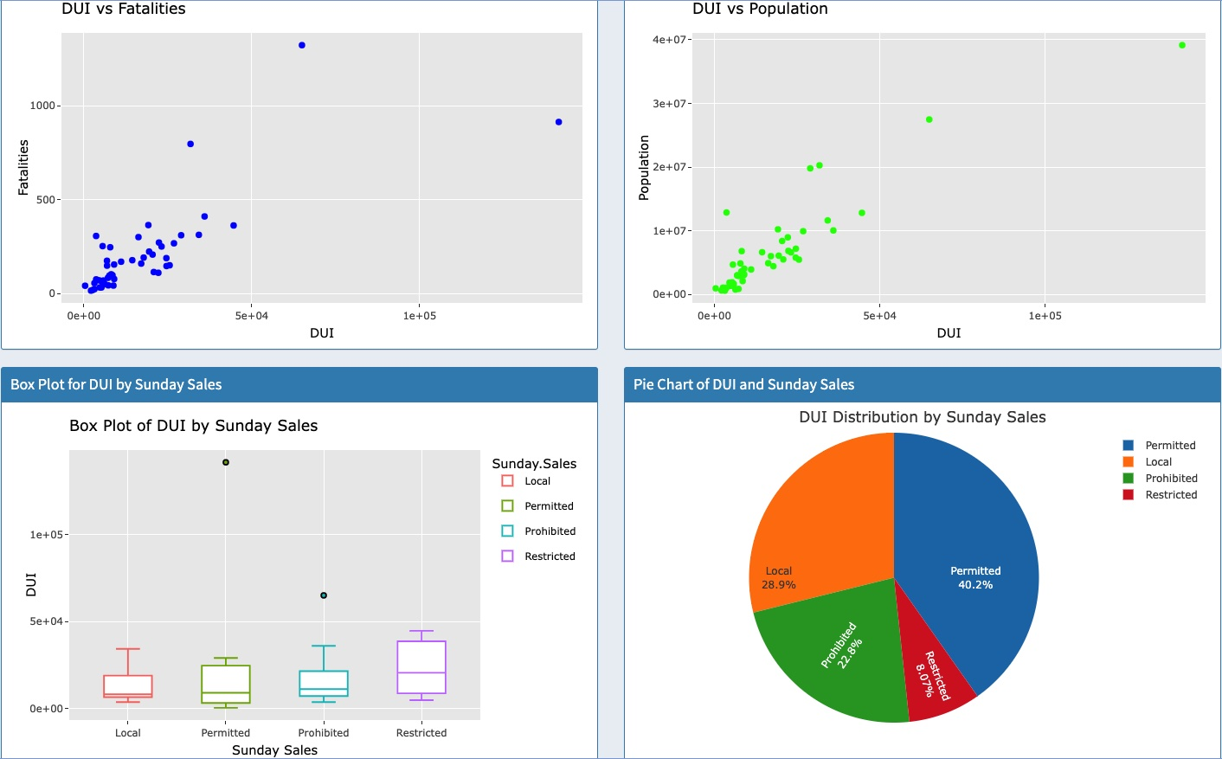
Visualizations Overview
The Visualizations Tab of the DUI and Fatalities Dashboard provides a variety of interactive visualizations to give a comprehensive overview of DUI and fatality data across various states. It is a quick snapshot of the most meaningful data.

Slide 9
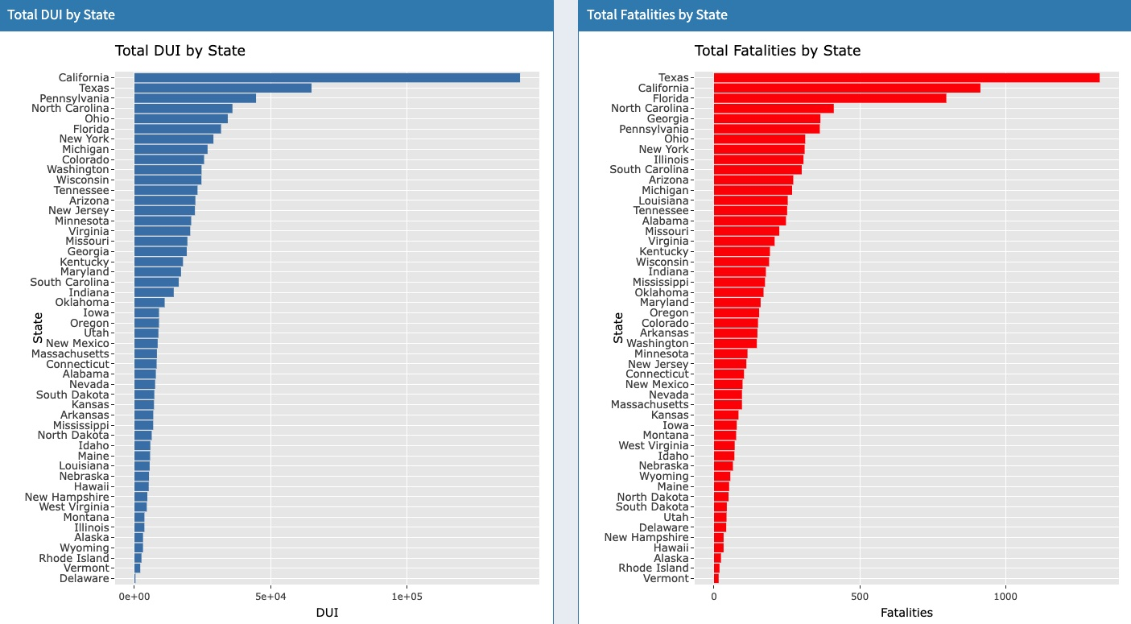
Bar Charts
Total DUI by State: This bar chart shows the total number of DUI incidents reported in each state. States with higher populations, such as California and Texas, report more DUI incidents.
Total Fatalities by State: This bar chart shows the total number of fatalities related to DUI incidents for each state. States like Texas and California have high fatality rates, reflecting both higher DUI incidents and a larger population. States with lower fatalities often have fewer DUI incidents or smaller populations.

Slide 10
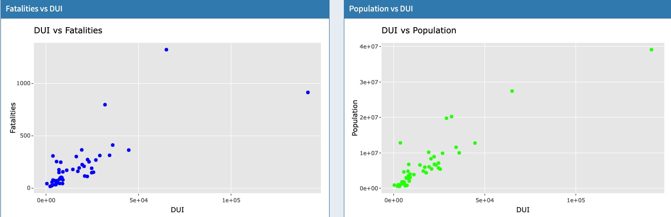
Scatter Plots
Fatalities vs DUI: This scatter plot visualizes the relationship between fatalities and DUI incidents. Each point represents a state, showing how DUI rates correlate with the number of fatalities. There is a positive correlation between DUI incidents and fatalities. States with higher DUI incidences tend to have more fatalities. However, some states may have high DUI rates but low fatalities due to differences in enforcement, road safety measures, or medical care.
Population vs DUI: This scatter plot visualizes a positive correlation between DUI incidents and a state’s population. States with higher populations tend to have higher DUI rates.

Slide 11
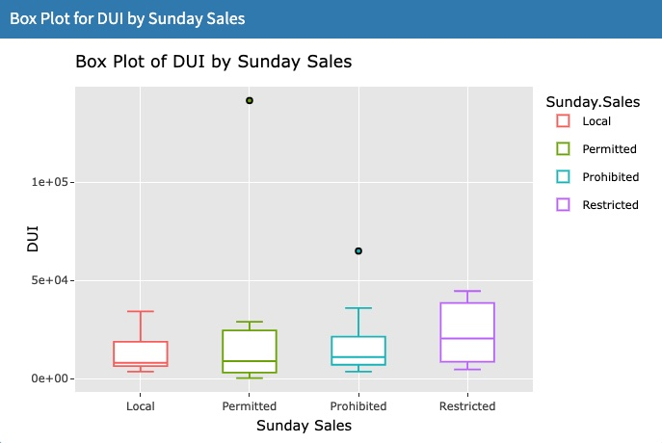
Box Plot
DUI by Sunday Sales Regulation: This box plot displays the distribution of DUI incidents across various Sunday sales regulations. The distribution of DUI incidents varies across different Sunday sales regulations. States with Local restrictions have the lowest DUI incidences. Although, local, permitted and prohibited restrictions are very similar in DUI incidence rates suggesting other factors could be at play.

Slide 12
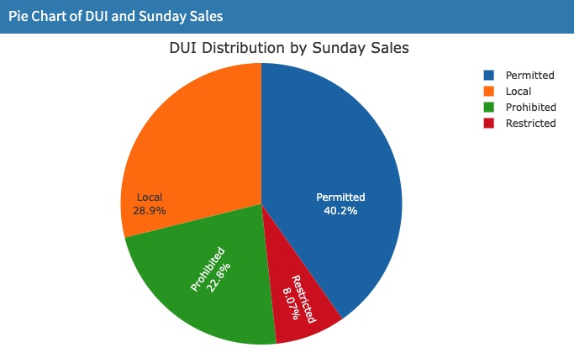
Pie Chart
DUI Distribution by Sunday Sales: This pie chart shows the proportion of DUI incidents under different Sunday sales regulations. It provides a visual comparison of DUI counts based on regulatory status. States with Permitted Sunday sales have the largest share of DUI incidents while states with Restricted Sunday sales have the lowest share.

Slide 13

Insights
The visualizations collectively showcase patterns and trends in DUI incidents and fatalities and how they correlate with state population and regulatory conditions.
While Sunday sales regulations might be one factor of DUI rates, there are several other factors affecting DUI incidents and fatalities.
Each visualization provides a foundation for further investigation into how other factors may contribute to DUI and fatality rates. This can help guide future research and policy changes.

Slide 14
Deployment and Access
All the materials and code used for this project can be found on GitHub at this link:
https://github.com/aishsun/DATA-824-Final-Project.git

Slide 15
Conclusion
This app aims to provide a comprehensive analysis of DUI and fatality rates in all 50 U.S states. It allows users to explore how different factors, including Sunday sales regulations and state population, impact these rates and vehicle-related deaths. This tool aids in informed decision-making and policy considerations by visualizing trends and correlations in an easy way.
The visualizations reveal a clear positive relationship between DUI incidents and vehicle-related fatalities, as well as between DUI incidents and state population.
The number of DUI incidents and fatalities varies between states, suggesting that there are differences in population size, alcohol consumption, and state policies.
Analysis of DUI incidents by Sunday sales regulations shows variability in DUI rates depending on whether alcohol sales are Permitted, Prohibited, Local or Restricted.

Slide 16
Bibliography
https://www.nhtsa.gov/risky-driving/drunk-driving
https://www.responsibility.org/alcohol-statistics/
https://www.responsibility.org/alcohol-statistics/state-map/
https://www.kaggle.com/datasets/bryanmaloney/dui-arrests-and-population-by-state-2015-usa/data
https://www.skofirm.com/news/new-indiana-law-will-end-ban-on-happy-hour-permit-carry-out-alcohol-and-establish-new-liquor-liability-insurance-requirements/

